Slide 1
Reproductive disorder disease
In simple language this can defined as disease affecting that lead to infertility or sterility
fertility : ability of an animal to reproduce
Infertility : temporary inability of the animal to reproduce
Sterility : permanent inability of the animal to reproduce
Causes :
1-anatomical (hereditary disease) or structural defector
2-functinal defect(hormonal disease)
3-infection causes
4-mangmente causes

Slide 2
Oophoritis / ovaritis
Inflammation / infection of ovary
Causes :
1- Secondary to trauma
2- infection through uterus
3- extension of infection through uterine walls
Treatment :
Not easy . Supportive treatment .
If infection extended through uterus treatment of the condition

Slide 3
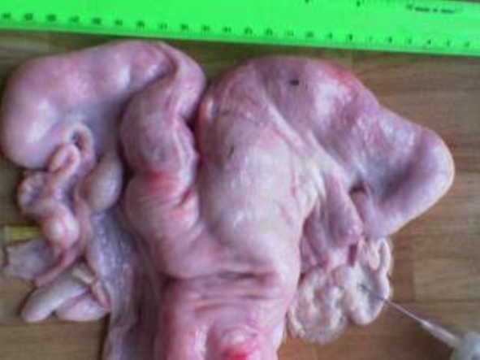
Salpingitis
Single para-ovarian cyst
Pyosalpinx in the right and left oviducts

Slide 4
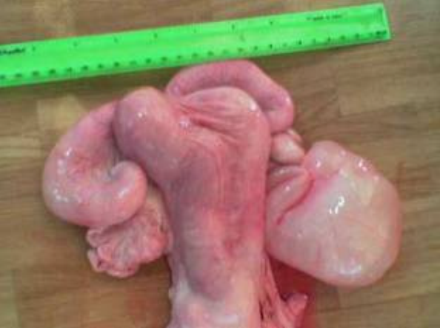
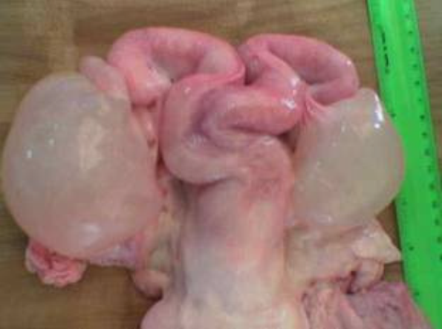
Salpigitis
Unilateral hydrosalpinx in the right oviduct
Bilateral hydrosalpinx

Slide 5
endometritis
"Inflammation of endometrium extending not deeper than the stratum spongiosum is called endometritis".
Clinical signs :
1- White or whitish-yellow mucopurulent vaginal discharge comes out when a diseased cow sit down.
2- mucopurulent discharge at the time of estrous.
3- No signs of systemic illness like septic puerperal metritis.
4- Repeat breeding and failure of conception are the most common symptoms of endometritis
Classification :
1- Clinical endometritis: When the uterine discharge is thrown by the animal, is mucopurulent, it is called clinical endmetritis.
2 - Subclinical endometritis: When the uterine discharge is thrown by the animal is almost clear, but give positive reaction to white side test, this condition is called subclinical endometritis

Slide 6
Treatment:
(1) Antimicrobial therapy Oxytetracycline treatment is effective in most of the mixed bacterial infection that exists in the early post-partum uterus.
(2) Hormonal therapy:
A- Oestradiol valerate - Dose 3 to 10 mg. I/M. This treatment can be repeated at an interval of 7 days if required.
B-Oxytocin: Administer low dose (10 to 20 IU) of oxytocin within 4 to 6 hours of the oestrogen injection.
C- PGF2a analogues: When corpus luteum is present, PGF2α is the most successful treatment both in terms of cure rate and calving to conception interval. Lutalyse 5 ml. I/M.
(3) Supportive therapy
Mineral mixture containing Vit. A, D & E helps in regeneration of damaged endometrium and enhances immunity and tone of the uterine muscles

Slide 7
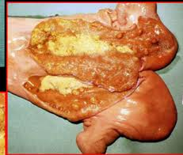
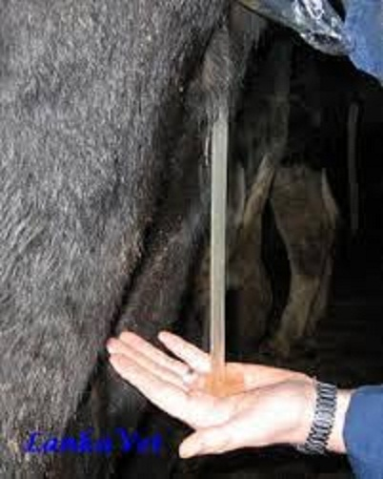
Endometritis in cow

Slide 8
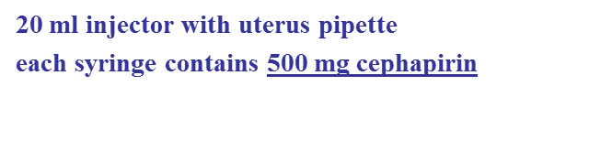
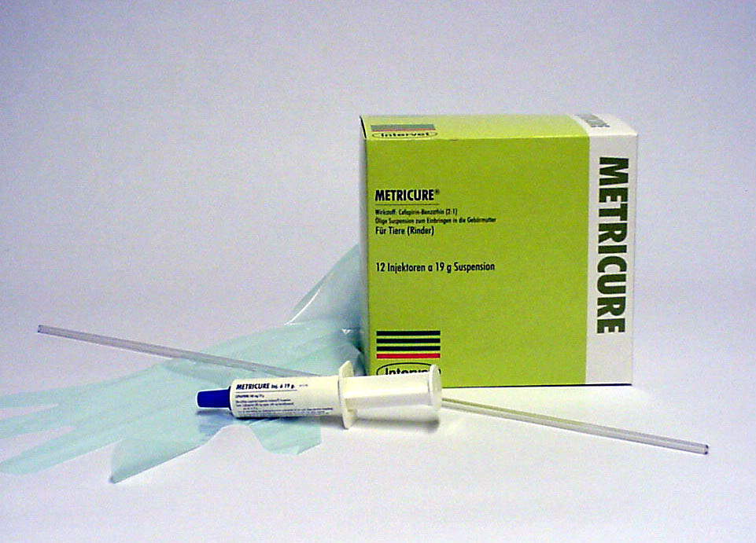
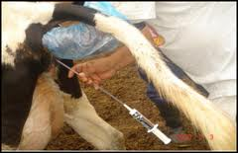
Use metricure to treatment endometritis
Use metricure

Slide 9
Pyometra
Pyometra is characterized by the accumulation of pus in the uterus and by a retained corpus luteum with failure of estrous". it classified closed pyometra or open pyometra
Clinical Signs :
1- In postpartum pyometra, the cervix does not remain too tight.
So some of the pus escapes when the cow lies down, urinates or
defecates.
2- Fail to show estrous symptoms.
3- per-rectal examination:
A- Uterus remains enlarged both the sides.
B- Uterine wall is thicker than what it is during pregnancy
C- Presence of corpus luteum
D- Uterus has more' doughy' (uterus is felt like soft balls of
wheat-flour when fingers are pressed into)
E- No caruncles

Slide 10
Treatment
1- Oestrogen and Oxytocin therapy: Oestradiol valerate 3-10 mg. intramuscularly followed by Oxytocin 20 IU - 40 IU 24 hours later to sensitize the myometrium and dilate the cervix.
2-The best treatment is the use of PGF2α analogues like lutalyse (5 ml I/M). These cause regression of the corpus luteum, dilatation of the cervix and expulsion of pus within 5-7 days. Evacuation of the uterus is indicated by the signs of estrus.
3- Antimicrobial therapy: antibacterial drug is to be infused into the uterine lumen after expulsion of pus, penicillin is the drug of choice because after 25 to 30 days postpartum only c.pyogenes and Gram-negative anaerobes remain in the uterus of most of the cows with metritis or pyometra.
4- lugal’s iodine 0.5% intra uterine therapy :(0.5gram iodine +1grame potasium iodine complete to 100ml distal waters ) use 100- 500ml according to size of uterus.

Slide 11
Pyometra pregnancy
1- anestrous
2- persist corpus luteum
3- cervix closed or open
4- Uterine wall is thicker
5- Uterus has more' doughy
6- symmetric uterine horn
7- found pus in the uterus
8- no thrilling of middle uterine artery
8- treatment by prostaglandin
1- anestrous
2- found CL
3- the cervix closed
4- Uterine wall is thin wall
5- slipping of fetal membrane
6- asymmetric uterine horn
7- found fetus and caruncles in
uterus
8- thrilling of middle uterine artery
8- prevent give prostaglandin
because leads to abortion

Slide 12
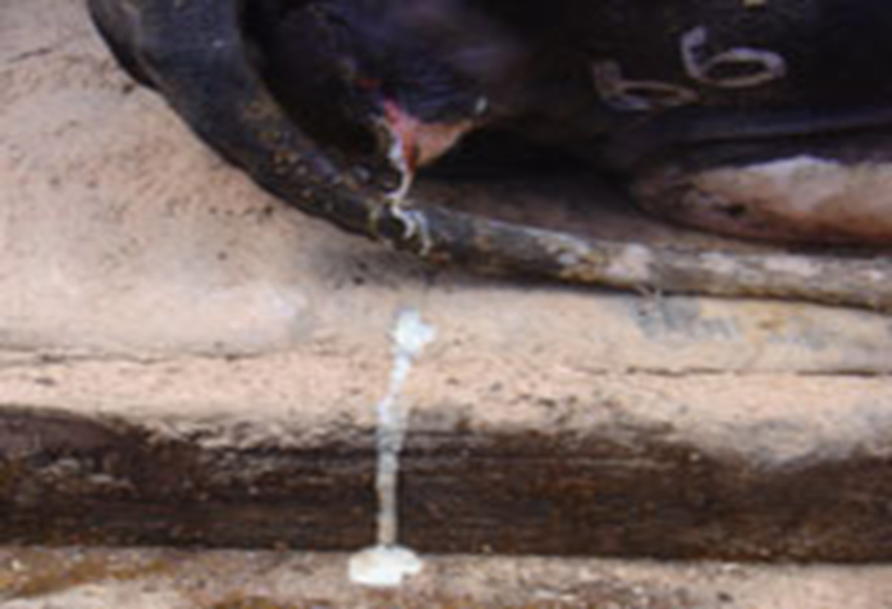
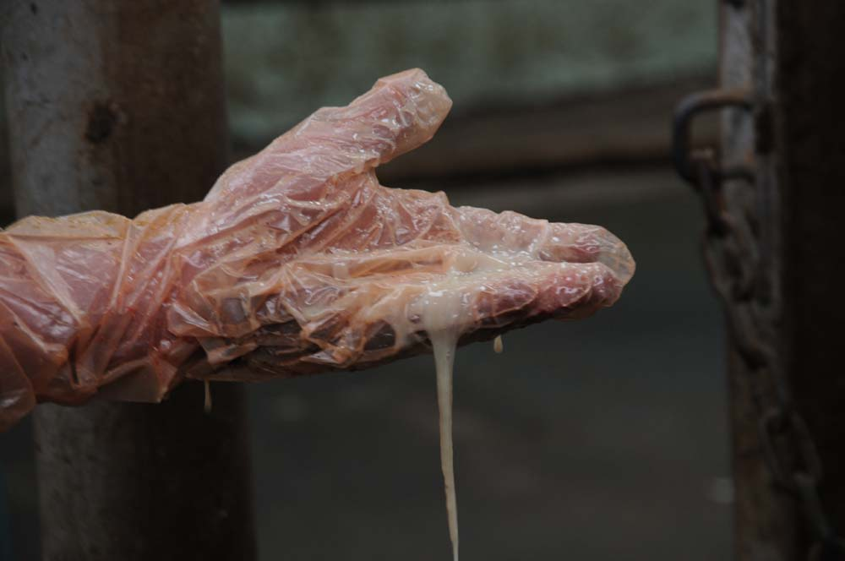
Open pyometra

Slide 13
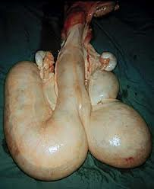
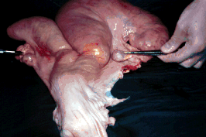
Pyometra in cow pregnancy

Slide 14
Cervicitis
definition Inflammation of cervix is associated with metritis following abnormal parturition through vaginal contamination.
Symptoms :
external os is edematous , swollen , prolapsed external fold . Reddish mucopuruleant cervical mucosa
Treatment :
1- Painting with lugal҆ s iodine
3- Uterine douche

Slide 15
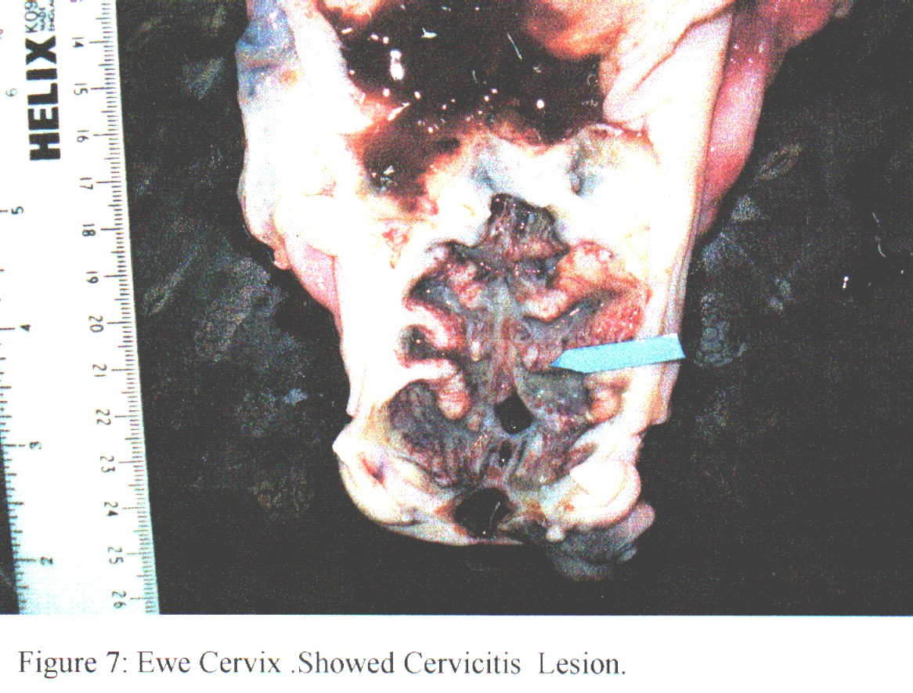

Slide 16
Vaginitis
Definition :often secondary to metritis or cervictis . Also as result of trauma and laceration .
Causes :
1- non spesific infection like strep.cocci , staph.cocci , corynebacterium.
2- specific causes like IBR, trichomonasis and vibriosis
Symptoms :
Mucopurulant yellow grey pus is discharged through vulva at irregular interval . On vaginal examination exudate is noticed on the vaginal floor , vaginal wall is inflamed , congest and edematous.
Treatment :
1- Flashing of vagina with mild antiseptics
2- Antibiotic infusion

Slide 17
Granular vulvo - vagintis
It is an infection disease of vulva and vagina characterized by :development of small elevated pustules or granules . The lesions are more common on the vulva than in vagina . In acute cases the pustules are highly inflamed causing a mucopurulent discharge , which may hang , or mat the hair coat around the tail.
Treatment
1- flushing with antiseptics .
2- antibiotics including local application

Slide 18
Abortion
Infectious Causes:
Bacterial
  Brucella spp
  Listeriosis
  Leptospirosis
  Arcanobacterium pyogenes
  Vibriosis
*Especially if abortion storm!
Protozoal
  Trichomonas
  Neospora
Viral
  IBR
  BVD
Mycotic

